Slide 1

REACT PROJECT PRESENTATION
Maayan Malka & lea benisty©

Slide 2
Maayan Malka & Lea Benisty The project was done as part of our studies at the seminar, as a client side development project. The goal is to enrich our knowledge with different technological tools

Slide 3
Development of a client-side project:
. The project languages: base React library, ReactDom, JS, JSX●
.The project was developed as a client side
Additional libraries: ●
Code-Management:
Mobx.
Design- libraries:
Material MUI, SweetAlert2.

Slide 4
The WebSite:
Admin-pages / User pages
User
Admin
Suit to ANY business

Slide 5
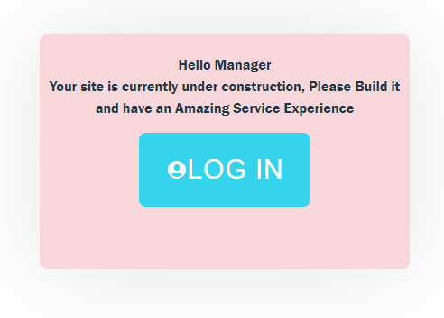
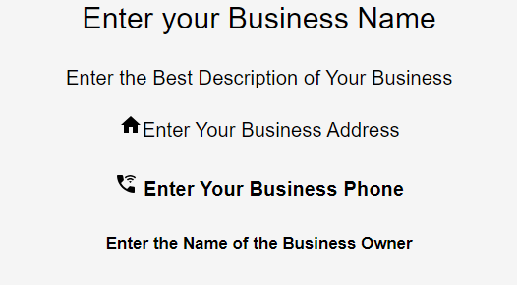
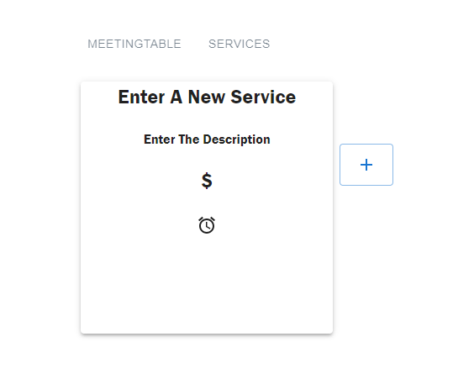
Enter in the first time
In the first time you enter your new website- the manager have to log in,
And enter details of his business and his services.
Only after doing it- the website will work, and the customer will start to come!

Slide 6
Enter in the first time
In the first time you enter your new website- the manager have to log in,
And enter details of his business and his services.
Only after doing it- the website will work, and the customer will start to come!

Slide 7
Enter in the first time
In the first time you enter your new website- the manager have to log in,
And enter details of his business and his services.
Only after doing it- the website will work, and the customers will start to come!

Slide 8
Enter in the first time
In the first time you enter your new website- the manager have to log in,
And enter details of his business and his services.
Only after doing it- the website will work, and the customers will start to come!

Slide 9
Enter in the first time
In the first time you enter your new website- the manager have to log in,
And enter details of his business and his services.
Only after doing it- the website will work, and the customers will start to come!

Slide 10
Enter in the first time
In the first time you enter your new website- the manager have to log in,
And enter details of his business and his services.
Only after doing it- the website will work, and the customers will start to come!

Slide 11
Enter in the first time
In the first time you enter your new website- the manager have to log in,
And enter details of his business and his services.
Only after doing it- the website will work, and the customers will start to come!

Slide 12
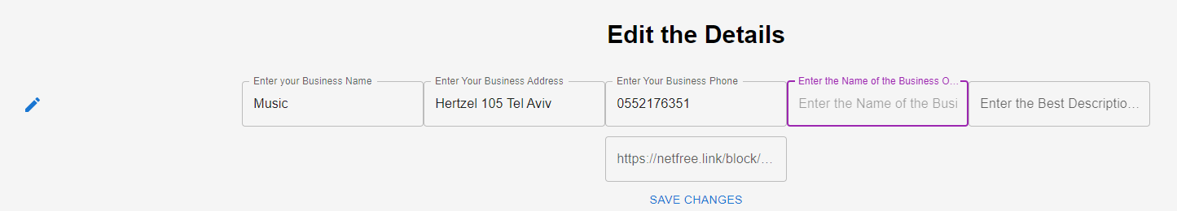
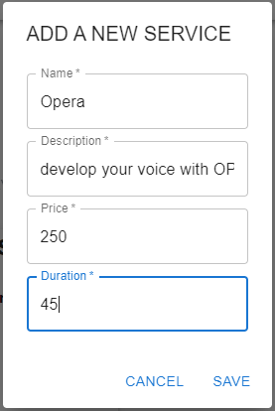
Edit the details…
Adding details and your services

Slide 13
Edit the details…
Adding details and your services

Slide 14
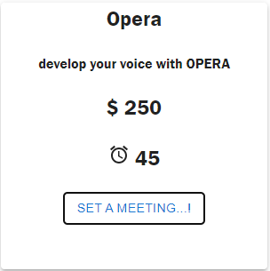
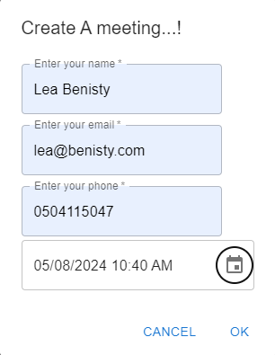

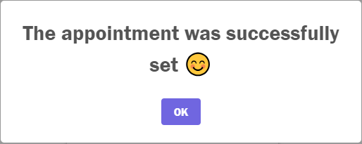
Create a new MEETING
The customer create a meeting and it send to the server

Slide 15
Create a new MEETING
The customer create a meeting and it send to the server

Slide 16
Create a new MEETING
The customer create a meeting and it send to the server

Slide 17
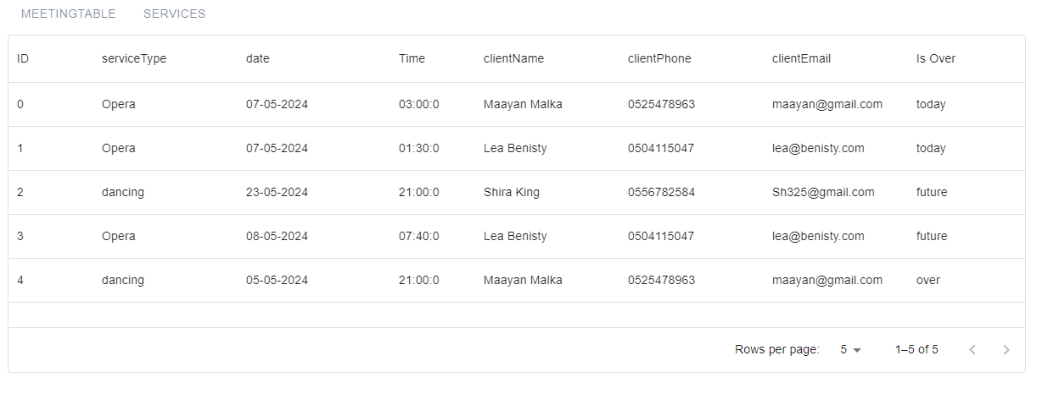
The Meeting Table at the admin page
The meetings are sorted by the Date

Slide 18
The-Challenges…
Time Management. ●
Using MUI components. ●
Create an appointment table. ●

Slide 19
Self-Learning
Things we added in our code:
Suitable to ANY GOAL. ●
Dark / Light mode – UseContex. ●
Manager login.●

Slide 20
Planes to the future…
Improving the Server. ●
Protecting the site by sending JWT. ●
Protection of the site from hacking. ●

Slide 21
